Slide 1
Leaky-wave antennas instruction lecture
EE4620
Spectral Domain Methods in Electromagnetics
May 2019

Slide 2
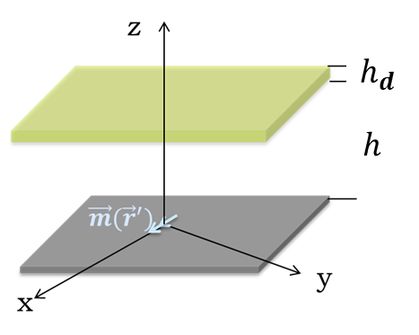
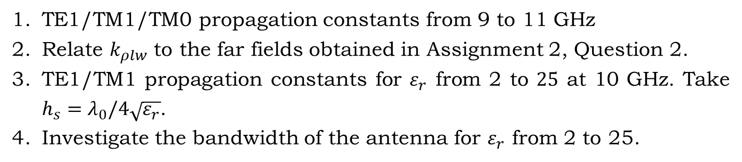
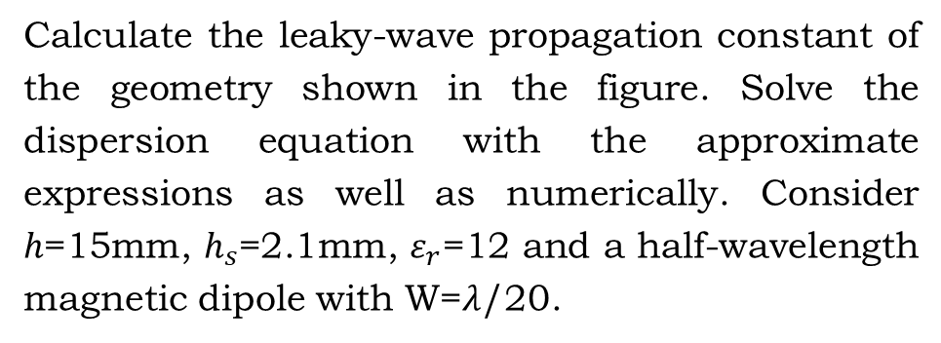
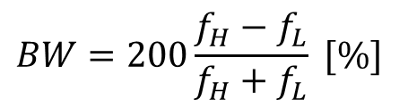
Question 1 (4 points)
Calculate the leaky-wave propagation constant of the geometry shown in the figure. Solve the dispersion equation with the approximate expressions as well as numerically. Consider $h$=15mm, $h_{s}$=2.1mm, $ε_{r}$=12 and a half-wavelength magnetic dipole with W=𝜆/20.
TE1/TM1/TM0 propagation constants from 9 to 11 GHz
Relate $k_{ρlw}$ to the far fields obtained in Assignment 2, Question 2.
TE1/TM1 propagation constants for $ε_{r}$ from 2 to $25$ at 10 GHz. Take $h_{s}=λ_{0}/4\sqrt{ε_{r}}$.
Investigate the bandwidth of the antenna for $ε_{r}$ from 2 to 25.
$$BW=200\frac{f_{H}−f_{L}}{f_{H}+f_{L}} [\%]$$

Slide 3



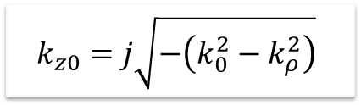

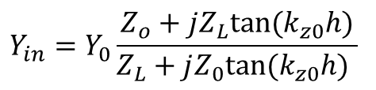





Dispersion Equation: Finding the poles
$$Z_{L}$$
Dielectric
$$ε_{r}$$
$$h$$
$$Z_{0}$$
PEC
$$h$$
$$ε_{r}=1$$
$$Y_{in}=Y_{0}\frac{Z_{o}+jZ_{L}tan⁡(k_{z0}h)}{Z_{L}+jZ_{0}tan⁡(k_{z0}h) }$$
The zeros of the dispersion equation correspond to poles of $Y_{in}$
$$D\left(k_{ρ}\right)=Z_{L}+jZ_{0}\tan{(k_{z0}h)}$$
$$Z_{L}=Z_{d}\frac{Z_{0}+jZ_{d}tan⁡(k_{zd}h_{d})}{Z_{d}+jZ_{0}tan⁡(k_{zd}h_{d})}$$
Note: use the bottom Riemann sheet To find the poles:
$$k_{z0}=j\sqrt{−\left(k_{0}^{2}−k_{ρ}^{2}\right)}$$

Slide 4
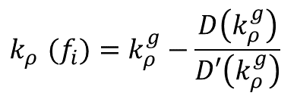
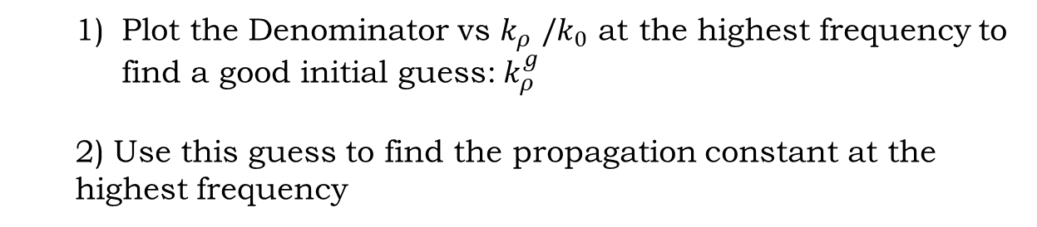

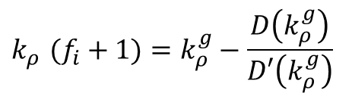
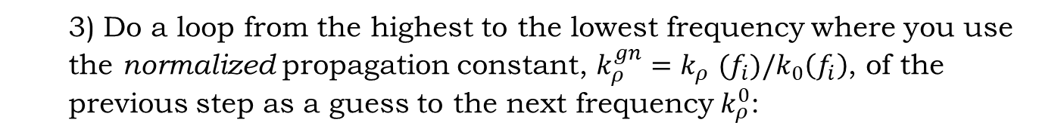
Iterative frequency loop to solve the dispersion equation numerically
Plot the Denominator vs $k_{ρ}^{}/k_{0}$ at the highest frequency to find a good initial guess:${ k}_{ρ}^{g}$
2) Use this guess to find the propagation constant at the highest frequency
$$k_{ρ}^{}(f_{i})=k_{ρ}^{g}−\frac{D\left(k_{ρ}^{g}\right)}{D′\left(k_{ρ}^{g}\right)}$$
3) Do a loop from the highest to the lowest frequency where you use the normalized propagation constant, $k_{ρ}^{gn}=k_{ρ}^{}(f_{i})/k_{0}\left(f_{i}\right)$, of the previous step as a guess to the next frequency $k_{ρ}^{0}$:
$$k_{ρ}^{}(f_{i}+1)=k_{ρ}^{g}−\frac{D\left(k_{ρ}^{g}\right)}{D′\left(k_{ρ}^{g}\right)}$$
with
$$k_{ρ}^{g}=k_{ρ}^{gn}k_{0}\left(f_{i}+1\right)$$

Slide 5

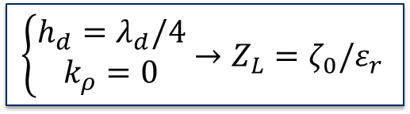


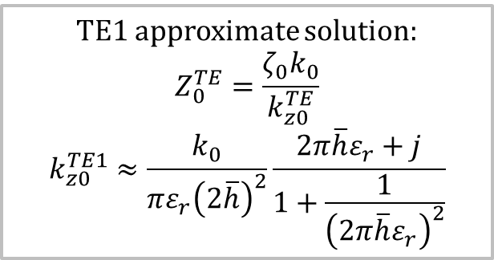
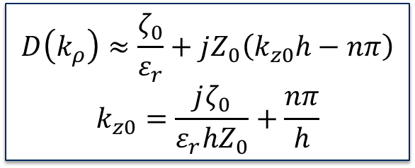


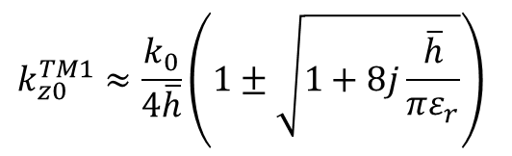
Dispersion Equation: analytical expression
$$→$$
Approximations to solve dispersion equation:
1.
$$\tan{(k_{z0}h)}≈k_{z0}h−nπ$$
$$D\left(k_{ρ}\right)≈\frac{ζ_{0}}{ε_{r}}+jZ_{0}\left(k_{z0}h−nπ\right)$$
$$k_{z0}=\frac{jζ_{0}}{ε_{r}hZ_{0}}+\frac{nπ}{h}$$
2.
$$\left\{\begin{aligned}h_{d}=λ_{d}/4 \\ k_{ρ}=0\end{aligned}\right.→Z_{L}=ζ_{0}/ε_{r}$$
TE1 approximate solution:
$$Z_{0}^{TE}=\frac{ζ_{0}k_{0}}{k_{z0}^{TE}}$$
$$k_{z0}^{TE1}≈\frac{k_{0}}{πε_{r}{\left(2\overline{h}\right)}^{2}}\frac{2π\overline{h}ε_{r}+j}{1+\frac{1}{{\left(2π\overline{h}ε_{r}\right)}^{2}}}$$
TM1/TM0 approximate solution:
$$Z_{0}^{TM}=\frac{ζ_{0}k_{z0}^{TM}}{k_{0}}$$
$$\overline{h}=h/λ$$
$$k_{z0}^{TM1}≈\frac{k_{0}}{4\overline{h}}\left(1±\sqrt{1+8j\frac{\overline{h}}{πε_{r}}}\right)$$
$${\left(k_{z0}^{TM0}\right)}^{2}≈\frac{{jk}_{0}}{ε_{r}h}$$
A. Neto and N. Llombart, “Wideband localization of the dominant leaky wave poles in dielectric covered antennas,” IEEE Antennas Wirel. Propag. Lett., vol. 5, no. 1, pp. 549–551, 2006.

Slide 6
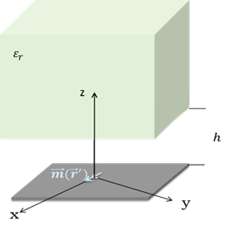
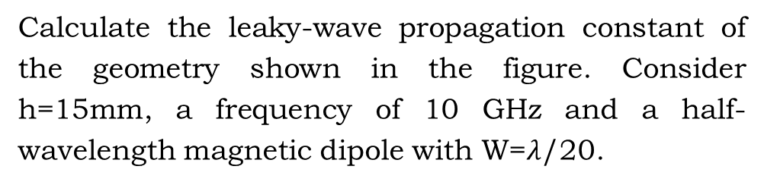
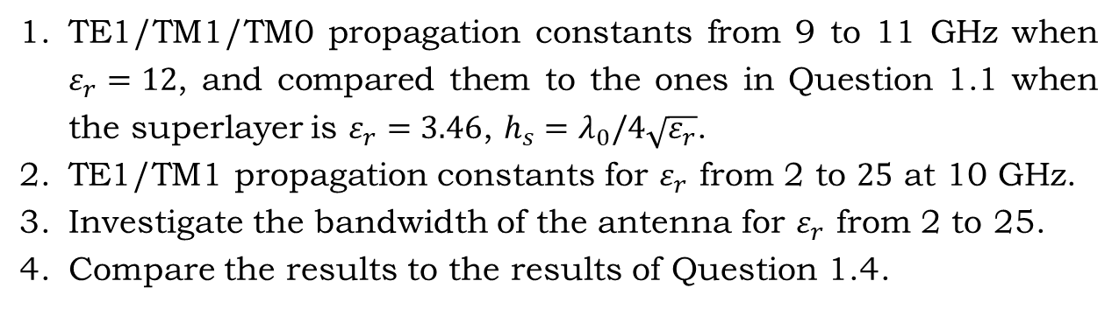
Question 2 (3 points)
Calculate the leaky-wave propagation constant of the geometry shown in the figure. Consider h=15mm, a frequency of 10 GHz and a half-wavelength magnetic dipole with W=$λ$/20.
TE1/TM1/TM0 propagation constants from 9 to 11 GHz when $ε_{r}=12$, and compared them to the ones in Question 1.1 when the superlayer is $ε_{r}=3.46$, $h_{s}=λ_{0}/4\sqrt{ε_{r}}$.
TE1/TM1 propagation constants for $ε_{r}$ from 2 to $25$ at 10 GHz.
Investigate the bandwidth of the antenna for $ε_{r}$ from 2 to 25.
Compare the results to the results of Question 1.4.

Slide 7


Dispersion Equation: Finding the poles
$$Z_{L}$$
$$h$$
$$Z_{0}$$
$$Y_{in}=Y_{0}\frac{Z_{o}+jZ_{L}tan⁡(k_{z0}h)}{Z_{L}+jZ_{0}tan⁡(k_{z0}h) }$$
The zeros of the dispersion equation correspond to poles of $Y_{in}$
$$D\left(k_{ρ}\right)=Z_{L}+jZ_{0}\tan{(k_{z0}h)}$$
$$Z_{L}=Z_{d}$$
Note: use the bottom Riemann sheet To find the poles:
$$k_{z0}=j\sqrt{−\left(k_{0}^{2}−k_{ρ}^{2}\right)}$$

Slide 8
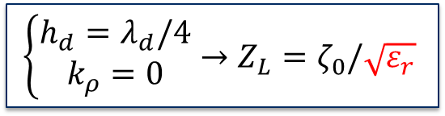


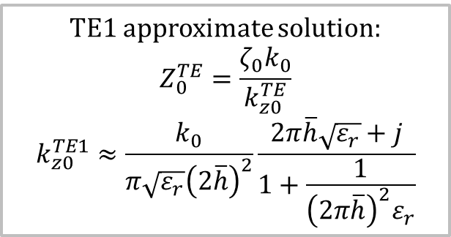
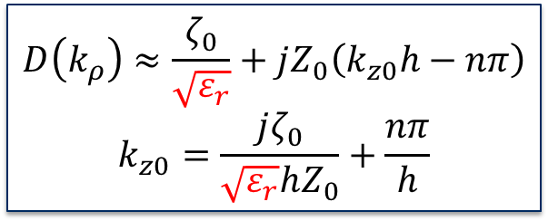

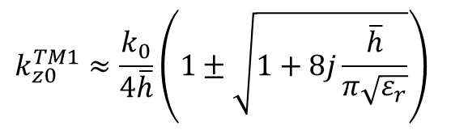
Dispersion Equation: analytical expression
$$→$$
Approximations to solve dispersion equation:
1.
$$\tan{(k_{z0}h)}≈k_{z0}h−nπ$$
$$D\left(k_{ρ}\right)≈\frac{ζ_{0}}{\sqrt{ε_{r}}}+jZ_{0}\left(k_{z0}h−nπ\right)$$
$$k_{z0}=\frac{jζ_{0}}{\sqrt{ε_{r}}hZ_{0}}+\frac{nπ}{h}$$
2.
$$\left\{\begin{aligned}h_{d}=λ_{d}/4 \\ k_{ρ}=0\end{aligned}\right.→Z_{L}=ζ_{0}/\sqrt{ε_{r}}$$
TE1 approximate solution:
$$Z_{0}^{TE}=\frac{ζ_{0}k_{0}}{k_{z0}^{TE}}$$
$$k_{z0}^{TE1}≈\frac{k_{0}}{π\sqrt{ε_{r}}{\left(2\overline{h}\right)}^{2}}\frac{2π\overline{h}\sqrt{ε_{r}}+j}{1+\frac{1}{{\left(2π\overline{h}\right)}^{2}ε_{r}}}$$
TM1/TM0 approximate solution:
$$Z_{0}^{TM}=\frac{ζ_{0}k_{z0}^{TM}}{k_{0}}$$
$$\overline{h}=h/λ$$
$$k_{z0}^{TM1}≈\frac{k_{0}}{4\overline{h}}\left(1±\sqrt{1+8j\frac{\overline{h}}{π\sqrt{ε_{r}}}}\right)$$
$${\left(k_{z0}^{TM0}\right)}^{2}≈\frac{{jk}_{0}}{\sqrt{ε_{r}}h}$$
A. Neto and N. Llombart, “Wideband localization of the dominant leaky wave poles in dielectric covered antennas,” IEEE Antennas Wirel. Propag. Lett., vol. 5, no. 1, pp. 549–551, 2006.

Slide 9
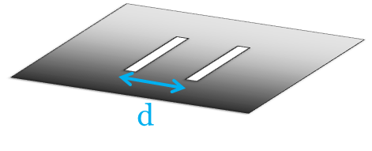
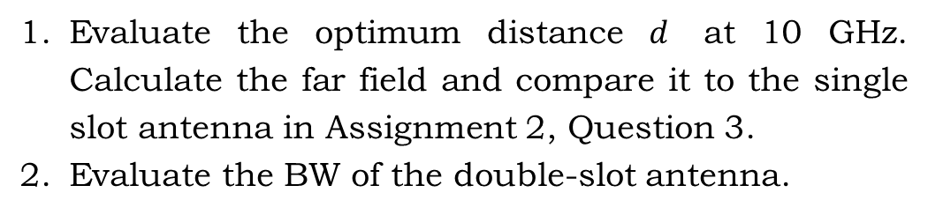
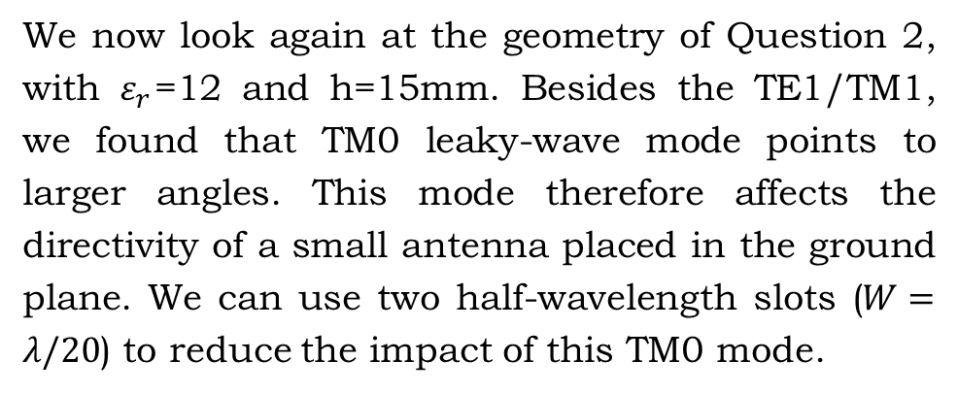
Question 3 (3 points)
We now look again at the geometry of Question 2, with $ε_{r}$=12 and h=15mm. Besides the TE1/TM1, we found that TM0 leaky-wave mode points to larger angles. This mode therefore affects the directivity of a small antenna placed in the ground plane. We can use two half-wavelength slots ($W=λ/20$) to reduce the impact of this TM0 mode.
Evaluate the optimum distance $d$ at 10 GHz. Calculate the far field and compare it to the single slot antenna in Assignment 2, Question 3.
Evaluate the BW of the double-slot antenna.

Slide 10
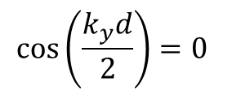
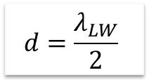
Double-slot antenna
Fourier transform of the current
${\vec{M}}_{2}={\vec{M}}_{1}$ $e^{jk_{y}d/2}+{\vec{M}}_{1} e^{−jk_{y}d/2}=$ ${\vec{M}}_{1}2\cos\left(\frac{k_{y}d}{2}\right)$
Cancelling the LW
$$\cos\left(\frac{k_{y}d}{2}\right)=0$$
$$d=\frac{λ_{LW}}{2}$$

